Slide 1

Start-Up Bridge
Presented by:- Sakshi Rithe (CS3136)
Gayatri Suryawanshi (CS3146)
Sonali Kotlapure (CS3151)
Guided by :-
Prof. Ms.M.P. Chaudhari

Slide 2
Contents
Introduction | This platform aims to go beyond the traditional matchmaking services.
Purpose & Scope | Transparent information sharing to aid informed decision-making.
Abstract | Facilitating investment opportunities within the startup ecosystem.
Identification of Problem Domain and Detailed Analysis | The challenges faced by startups in accessing funding and support, as well as the difficulties encountered by investors
Study of the Existing Systems and Feasibility of the Mini Project | Facilitating connections between investors and startups is a crucial step towards ensuring the project's success.
Objectives and Methodology of the Proposed Work | Seeking funding, streamlining the investment process for both parties.

Slide 3

01
Introduction

Slide 4

Introduction
"In the fast-paced world of business, startups bring fresh ideas, and investors provide the fuel to turn these ideas into reality."
A platform that encourages transparent information sharing to aid informed decision-making. Startups gain exposure, mentorship, and potential funding. Investors discover high-potential opportunities aligned with their interests.

Slide 5
Purpose & Scope
Facilitate Growth
Enhance Collaboration
Enable startups to access the necessary capital and resources for sustainable growth.
Foster a collaborative ecosystem where startups and investors can work synergistically
Address Challenges
Optimize Matchmaking
Investigate and address the challenges faced by startups in securing funding and building investor relations.
Develop innovative solutions, including algorithms, to optimize the matchmaking process between startups and investors.

Slide 6
Key features of project:
01
02
03
04
05
06
User authentication,
profiles & Effective Platforms
Pitch deck submission
Shortlisting mechanism
DataEnabling Investors to Discover the Investment Opportunities
Contributing to Economic Growth and Prosperity
Information Sharing

Slide 7
Detailed Analysis
Profile Creation
User Registration and Authentication
Pitch Presentation Submission
Implement a secure user registration and authentication system
Allow startups to create detailed profiles showcasing their business ideas
Provide startups with the ability to upload pitch presentations
Matchmaking Algorithms
Document Management
Messaging and Communication
Develop matching algorithms that suggest relevant startup pitches to investors
Facilitate communication between startups and investors through messaging features.
Enable startups to share additional documents

Slide 8
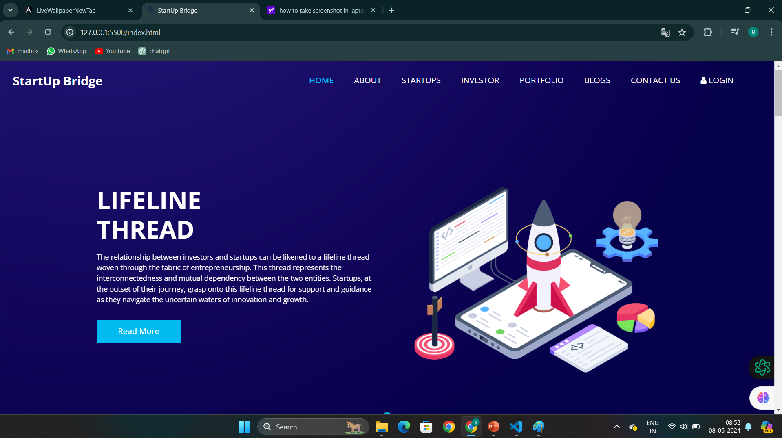
Feasibility Analysis of the Project
Frontend of our platform looks like this

Slide 9
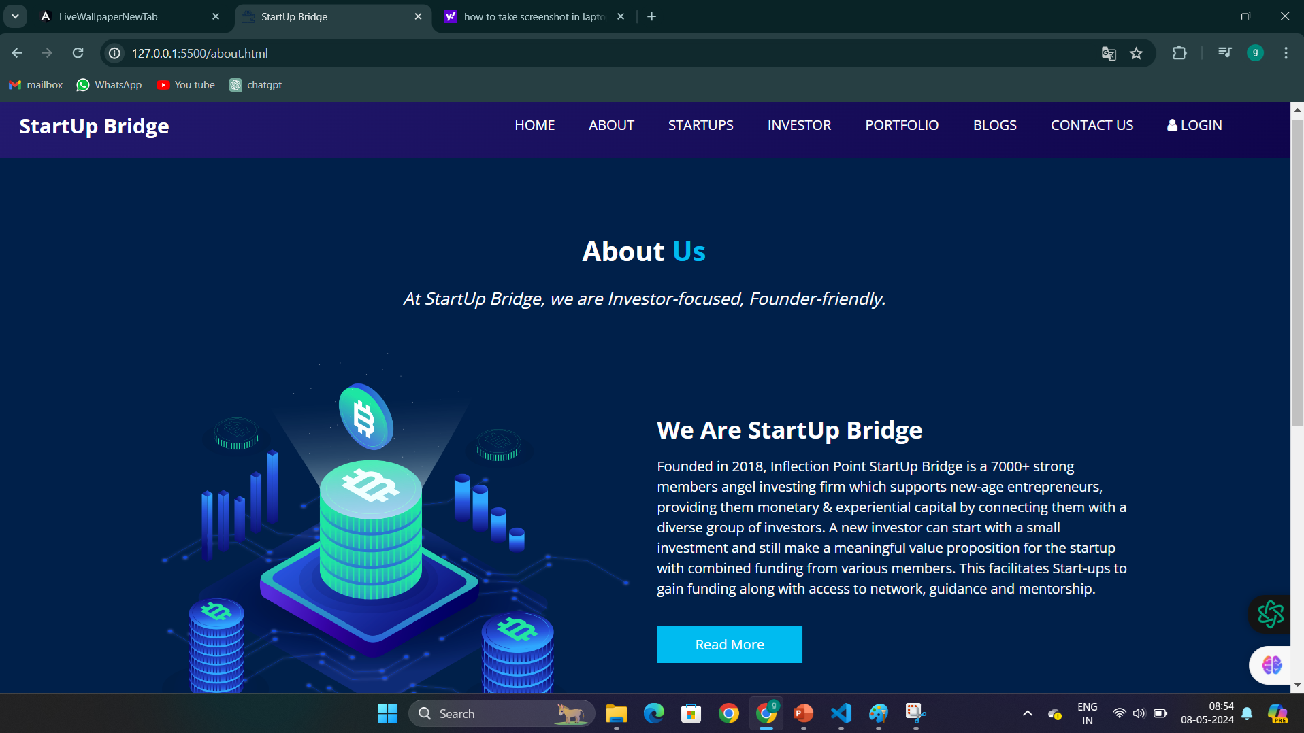
Feasibility Analysis of the Project

Slide 10
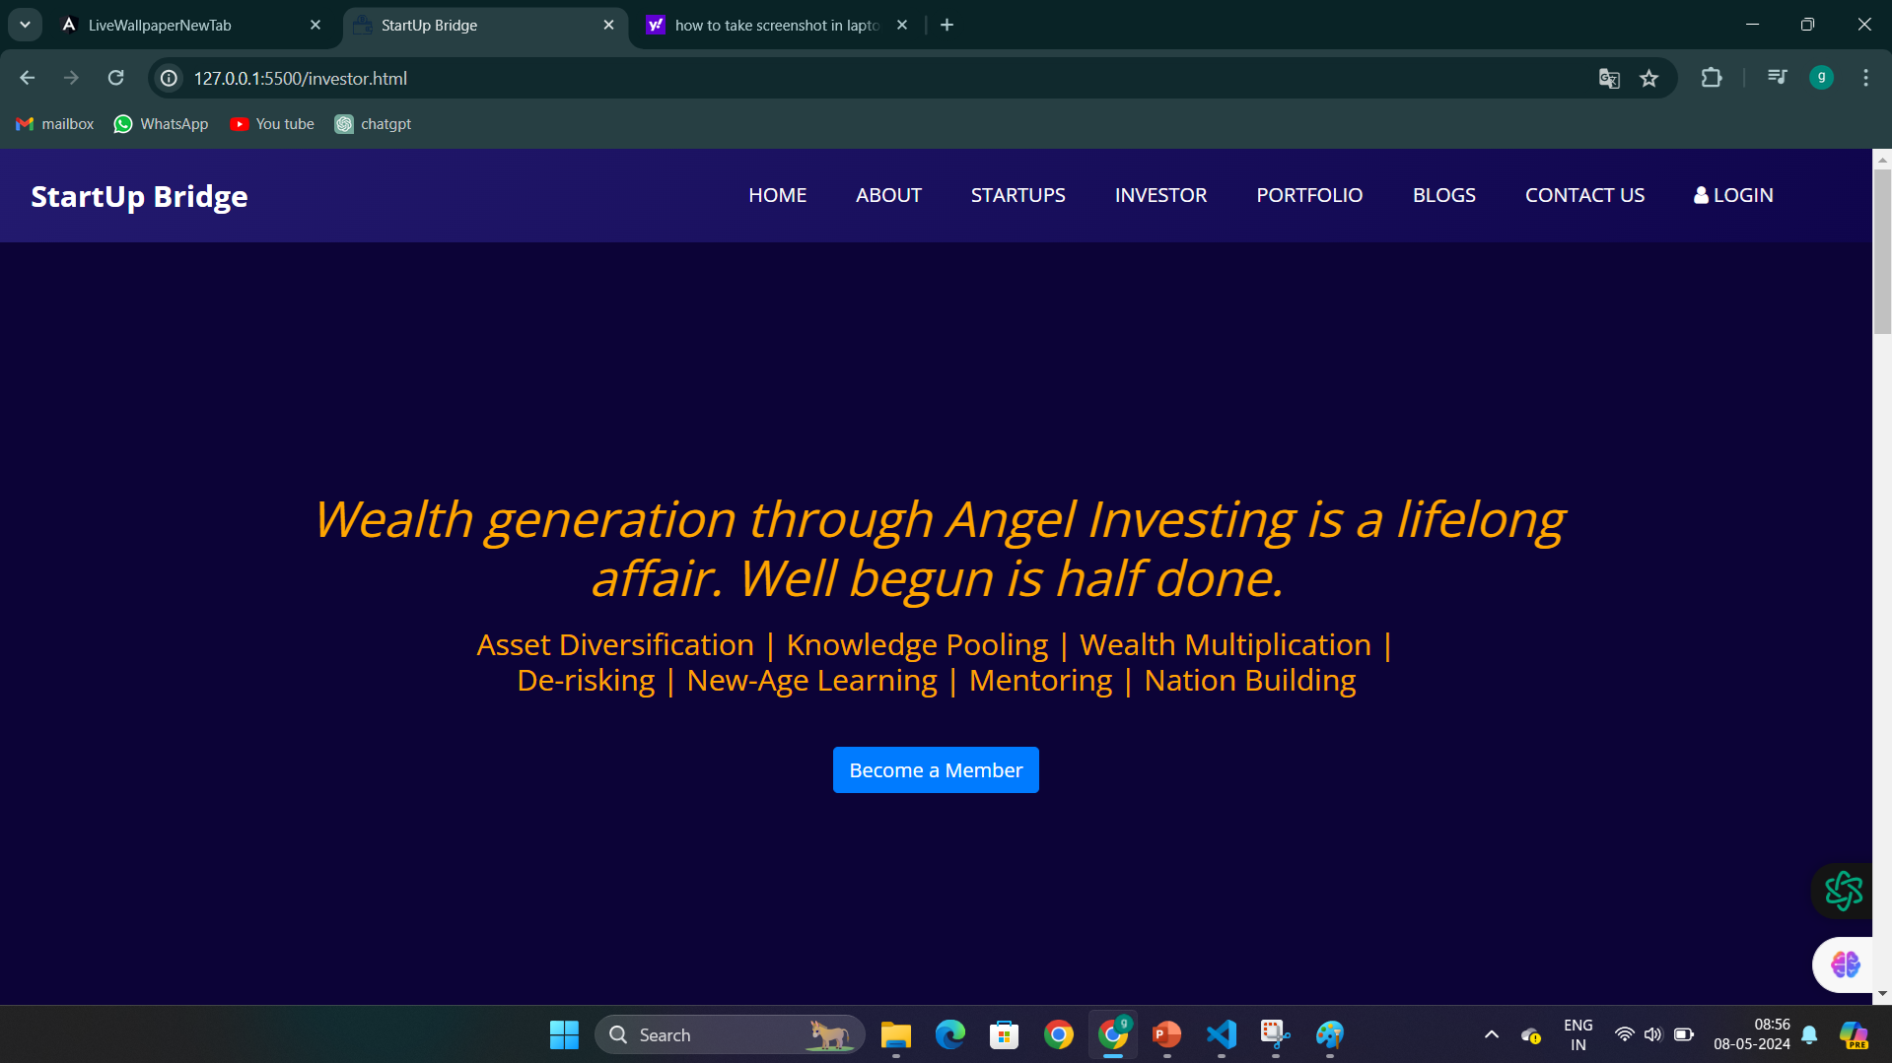
Feasibility Analysis of the Project

Slide 11
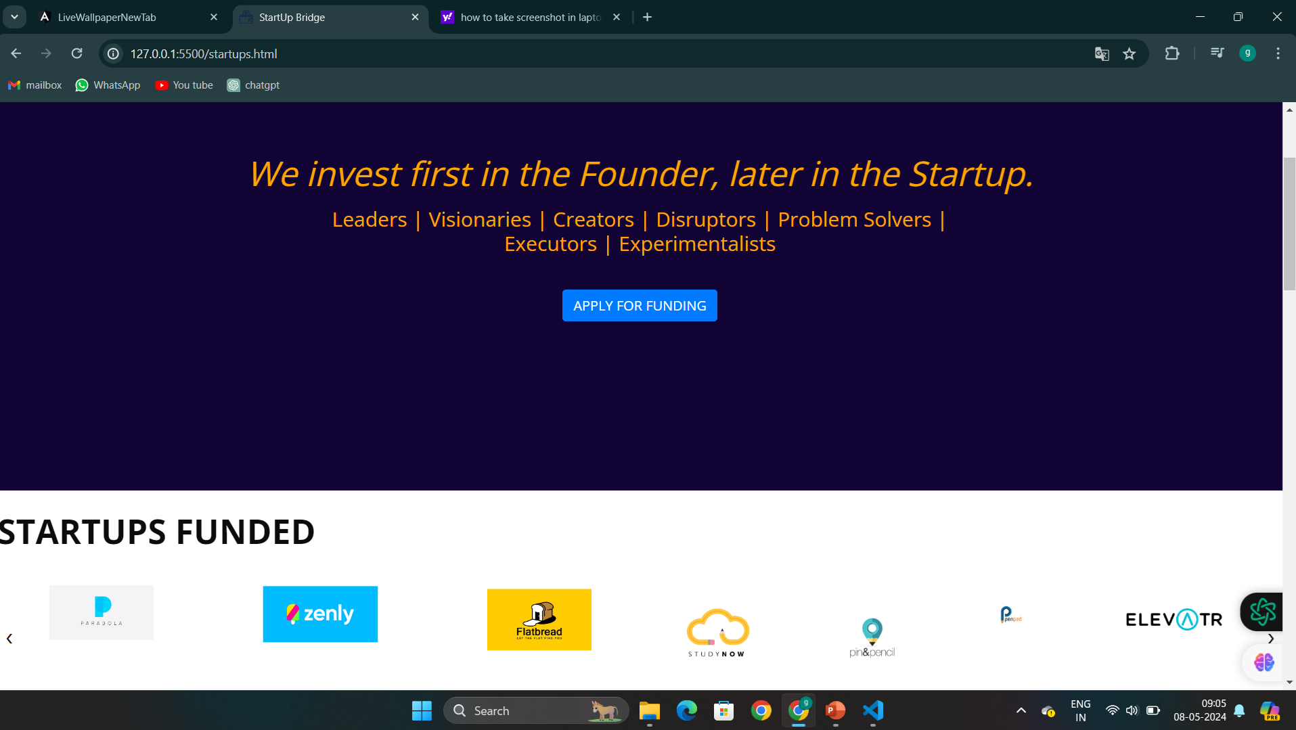
Feasibility Analysis of the Project

Slide 12
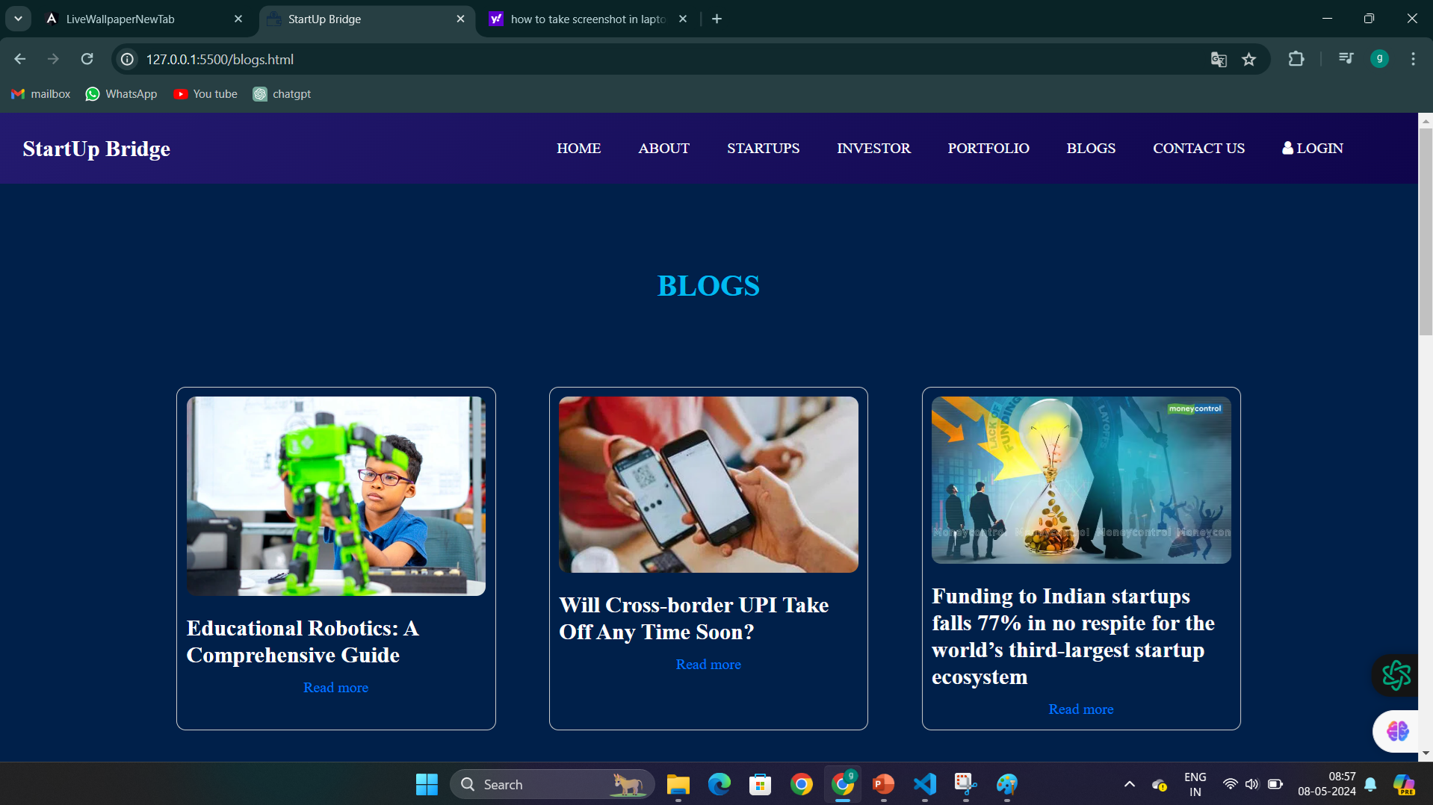
Feasibility Analysis of the Project

Slide 13
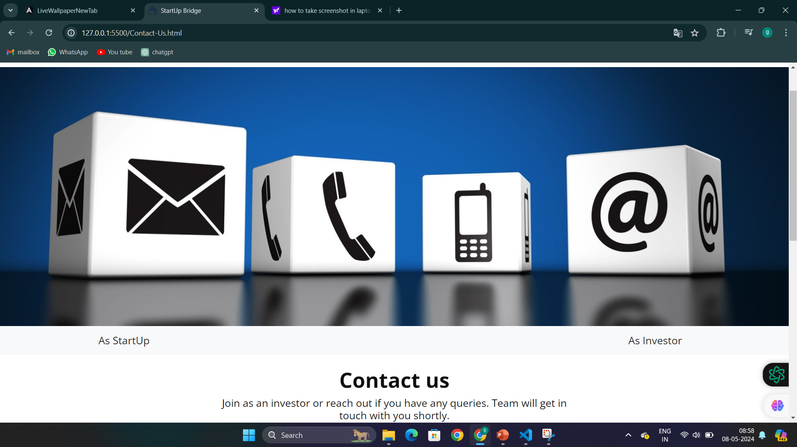
Feasibility Analysis of the Project

Slide 14
Feasibility Analysis of the Project
Technical Feasibility
Market Feasibility
Legal and Regulatory Feasibility
Project feasibility is high, availability of modern web development technologies and frameworks for building scalable and feature-rich platforms.
The startup ecosystem is dynamic and diverse, with numerous opportunities for collaboration and investment across various industries and regions.It focuses on growing demands for such platforms.
The project must be related to securities laws, data privacy regulations, and intellectual property rights because to ensure compliance with relevant laws and regulations governing fundraising activities, investor accreditation, and data protection.

Slide 15
Objectives and Methodology of the Proposed Work
Facilitate Connections
Streamline Investment Process
Develop a platform that facilitates meaningful connections between startups and investors.
Streamline the investment process by providing startups with a platform.
Enhance User Experience
Democratize Access to Funding
Prioritize user experience by designing an intuitive and user-friendly platform.
Provide startups with the ability to upload pitch presentations

Slide 16
Methodology of the Proposed Work
Requirement Analysis
Platform Design
Conduct in-depth requirement analysis to identify the needs, preferences, and pain points of startups, investors, and other stakeholders.
Design the platform architecture, user interface, and user experience based on the requirements
Technology Selection
Testing and Quality Assurance
Select appropriate technologies and frameworks for front-end and back-end development
Conduct comprehensive testing of the platform to identify and fix bugs, errors, and performance issues.

Slide 17
Conclusion
We've made it easy for startups to show off their awesome ideas and for investors to find the ones they love. It's like building a bridge between great ideas and the people who want to support them.
In the end, it's like creating a fantastic online neighborhood where everyone helps each other succeed.

Slide 18

Thank You

